Slide 1
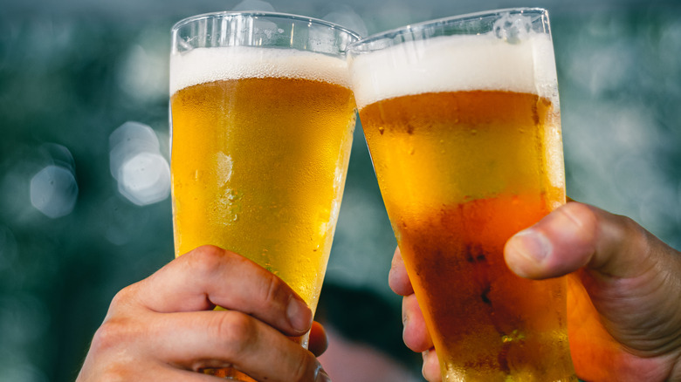
& Coffee Shop
The <Terminal Beer Co.
Group 7
Syntax Savants
Pedro Valdivia, Ismael Garcia,
Alex Nguyen, Alison Barker

Slide 2
We’re Opening a Brewery!
Using a 2017 dataset comprised of more than 500 breweries in the United States, we looked at the trends among beer drinkers to gain a better understanding of our future customers.
We wanted to know:
Where are people drinking the most beer?
Which styles are their favorite?
How much are they ordering (oz)?
Do customers prefer higher ABV?
How does higher ABV affect the taste(bitterness)?

Slide 3
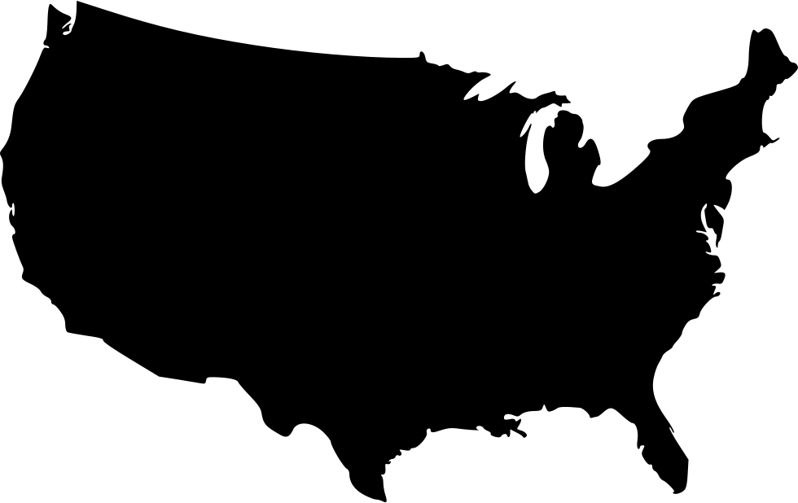
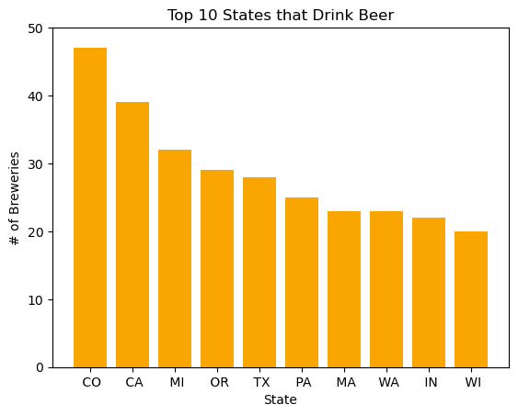
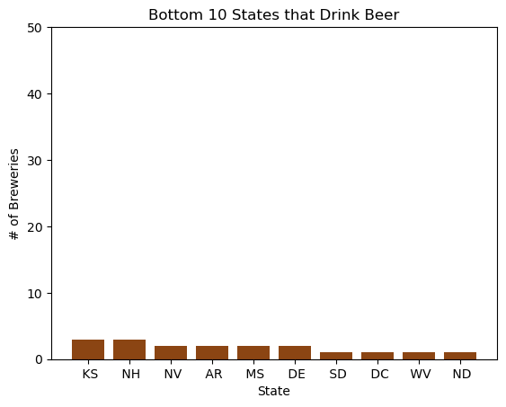
Where are people drinking the most beer?
Beer Lovers
Beer Haters
Notes:
Assumption is that states w/ more breweries enjoy drinking beer more (higher consumer base) and states w/ less breweries do not enjoy drinking beer as much (lower consumer base)
Want to ship mostly in-state as a start-up to avoid higher transportation costs
Colorado, California, and Michigan are Top 3 states
May consider states such as OR, TX, or PA to be slightly less competitive but still high in demand

Slide 4
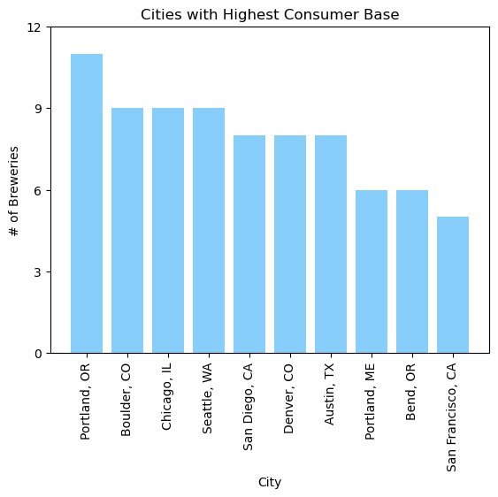
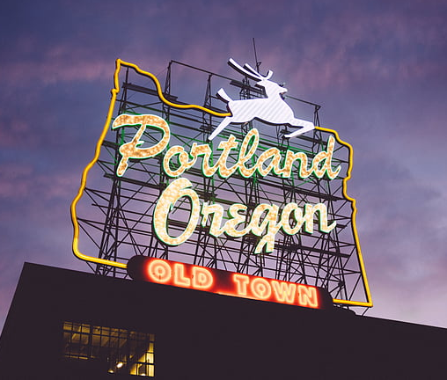
Where are people drinking the most beer? (cont.)
You’ll always find a place for beer in…
Portland, OR

Slide 5
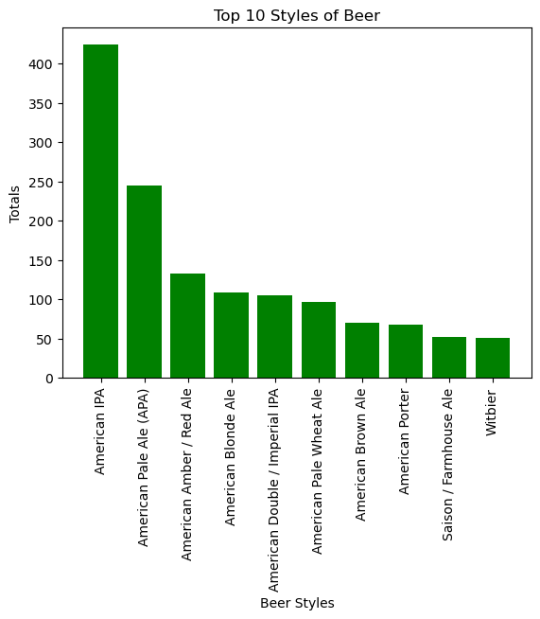
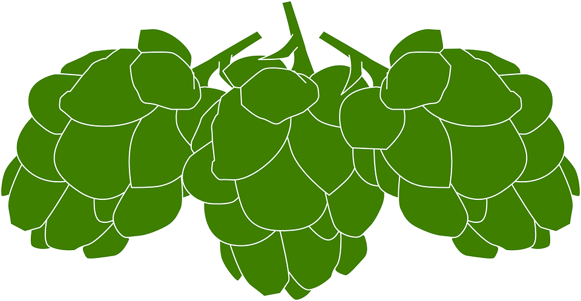
What are America’s Favorite Styles of Beer?
The #1 favorite style of beer is….
AMERICAN IPA

Slide 6
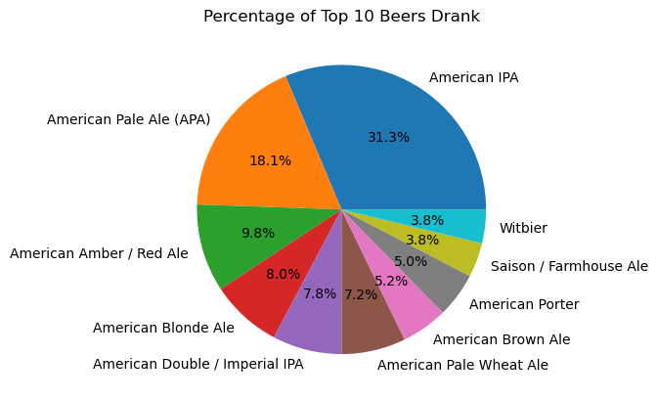
IPAs for the Win
What percentage of people are ordering American IPAs compared to other styles?
We found that the most ordered style of beer was an American IPA - by a lot.
31.3% of beer ordered was an American IPA. Hoppy drinking!!

Slide 7
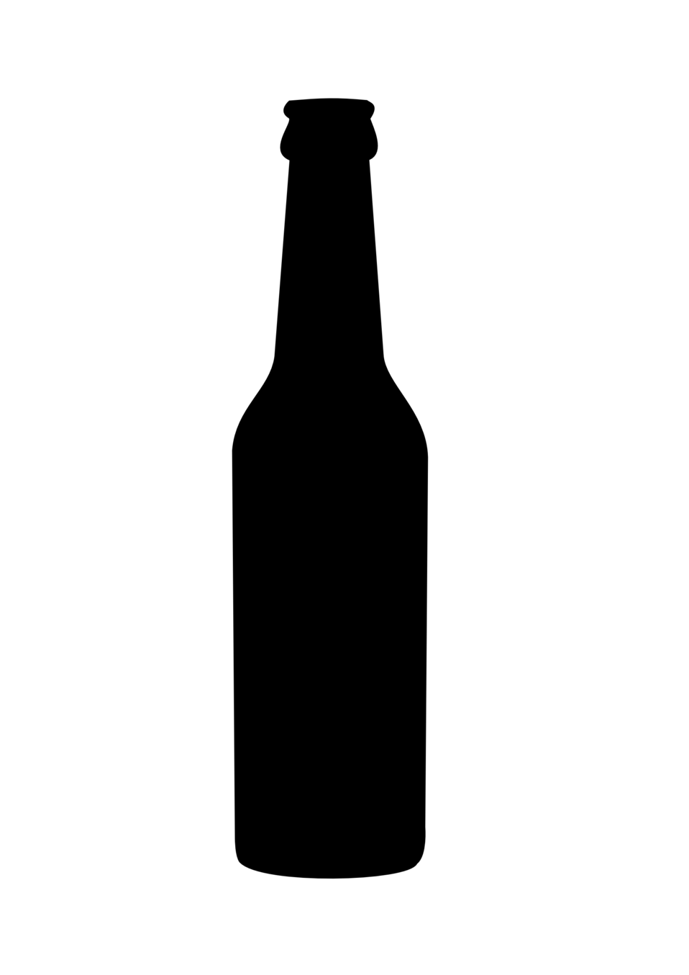
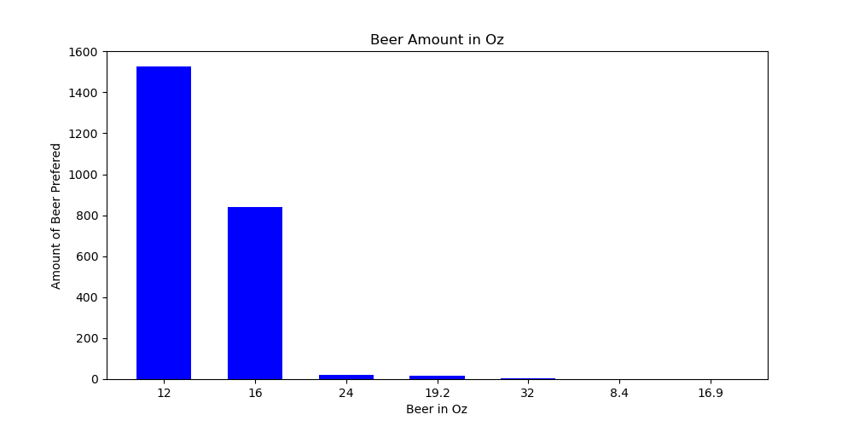
What is the preferred serving size for beer?
The most popular is…
The 12 ounce beer bottle coming in as the most popular.

Slide 8
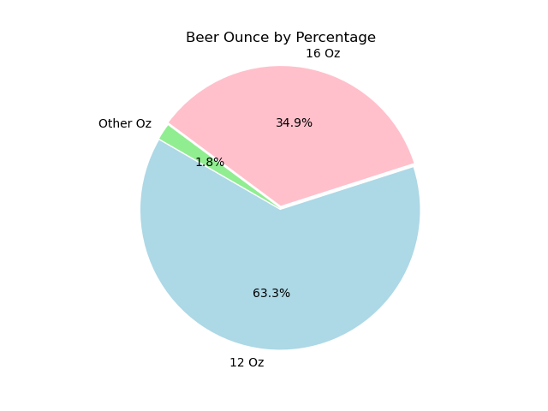
What is the preferred serving size for beer? (cont.)
By looking at the preferred serving sizes we can see the most popular amount is 12 oz followed by 16 oz.

Slide 9
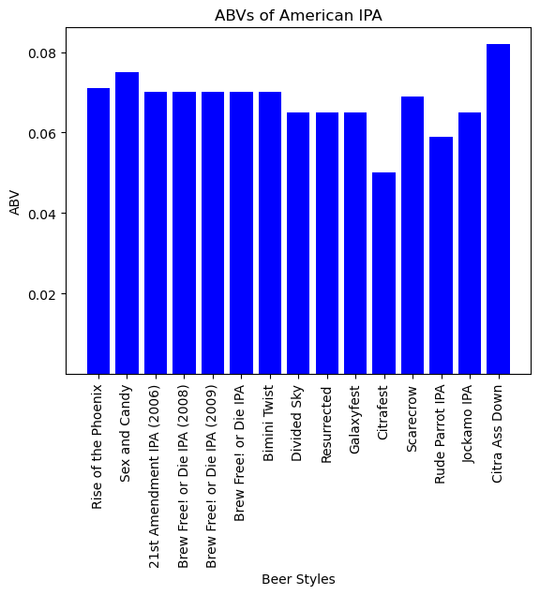
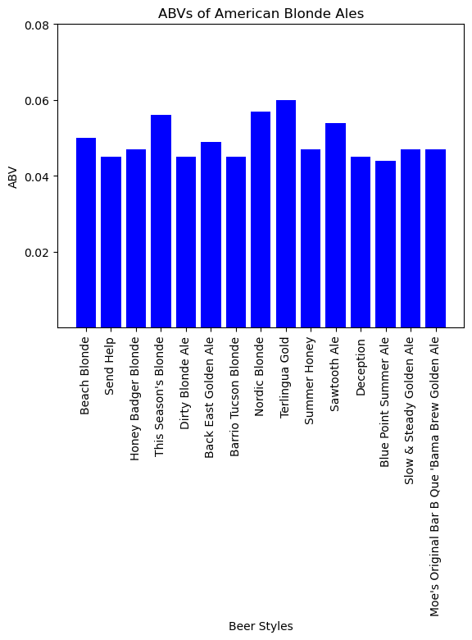
Comparison of the most popular
We also looked at the comparison of two of the top ten beers (American IPAs and American Blonde Ale) and their ABV percentages to see if IPAs tended to be higher.

Slide 10
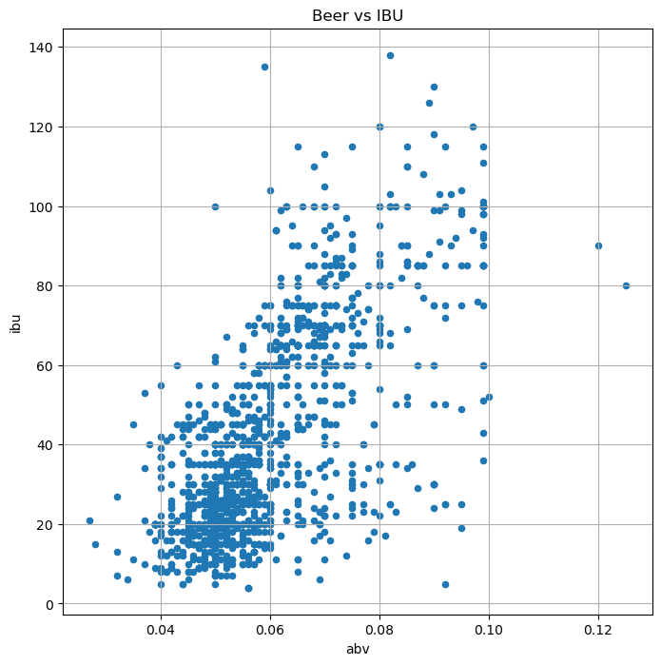
The more the better? Abv and bitter taste
A higher ABV indicates a stronger and more alcoholic beer. On the other hand, IBU measures the bitterness of a beer.
We found that the higher the alcohol by volume (ABV), the more bitter your drink will taste.

Slide 11
Analysis
Colorado has the most breweries overall, but Portland, OR is the hotspot for beer
Americans love their IPAs!
Based off the the data that we have 12 ounces is the most popular winning by more than half of the popularity at 63.3%
Our ABV/IBU data shows a positive correlation that states the higher the alcohol by volume, the more bitter the beer is.

Slide 12
We’ll see you at <The Terminal soon!
Cheers!

Slide 13
Resources
https://www.kaggle.com/datasets/nickhould/craft-cans

